Slide 1
Quick maximum distribution reduction in inconsistent decision tables
Authors: Baizhen Li, Wei Chen, Zhihua Wei, et al.
Email: baizhen9406@163.com
Institution affiliation: Tongji University

Slide 2
Background
In rough sets theory, there are five representative types of attribute reduction. Maximum distribution reduction (MDR) is one of it
Some points can be improved in MDR:
It is quite inconvenient to judge the maximum distribution reduct directly according to its definition
The heuristic function, used in attribute reduction algorithms, is hard to understanding
The existing heuristic based judgment methods are inefficient due to the lack of acceleration mechanisms

Slide 3
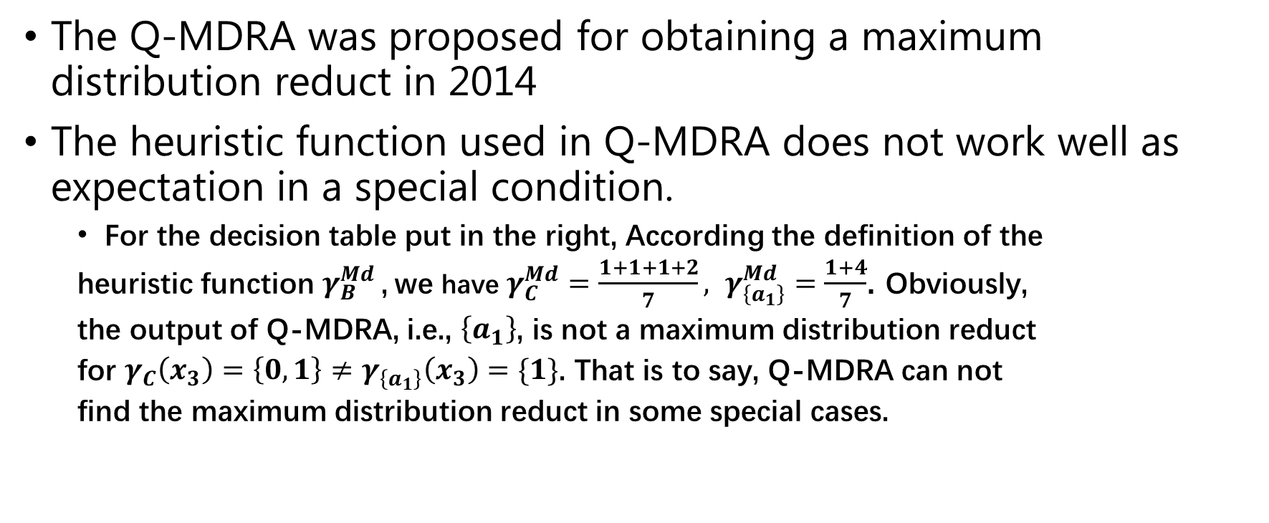
The defect of existing Q-MDRA algorithm
The Q-MDRA was proposed for obtaining a maximum distribution reduct in 2014
The heuristic function used in Q-MDRA does not work well as expectation in a special condition.
For the decision table put in the right, According the definition of the
heuristic function$γ_{B}^{Md}$, we have $γ_{C}^{Md}=\frac{1+1+1+2}{7}, γ_{\left\{a_{1}\right\}}^{Md}=\frac{1+4}{7}$. Obviously,
the output of Q-MDRA, i.e., $\left\{a_{1}\right\}$, is not a maximum distribution reduct
for $γ_{C}\left(x_{3}\right)=\left\{0,1\right\}≠γ_{\left\{a_{1}\right\}}\left(x_{3}\right)=\{1\}$. That is to say, Q-MDRA can not
find the maximum distribution reduct in some special cases.
Li Min, et al., Quick attribute reduction in inconsistent decision tables, Information Sciences, 254(2014) 155-180

Slide 4
The focus of our work
The correct, understandable heuristic function based, efficient maximum distribution reduction algorithms
How were we conducted work:
We analyze the property of indiscernibility relations of the maximum distribution reduct and associate it with the classical heuristic functions
Using the result of analyzing, we propose two new definitions of MDR based on the classical heuristic functions, i.e., the dependency, the consistency, the information entropy.
According to the classical heuristic functions, we develop two efficient algorithms for MDR

Slide 5
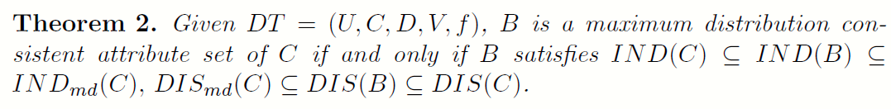
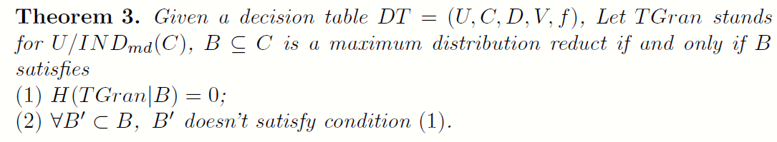
The indiscernibility relation of MDR
In contrast of the existing work, we concentrate on the indiscernibility relation of MDR and link it with the heuristic function designing

Slide 6
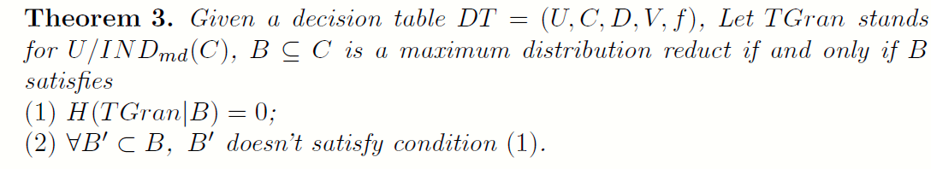
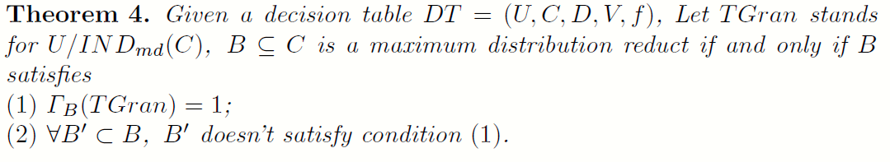
Two new definitions of MDR
Based on the indiscernibility relation of MDR, we construct the new definitions of MDR with the conditional entropy and the dependency degree.

Slide 7
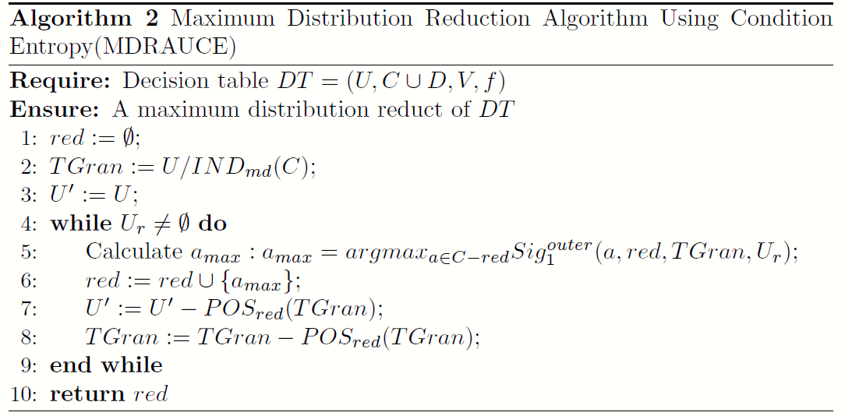
The more efficient algorithms

Slide 8
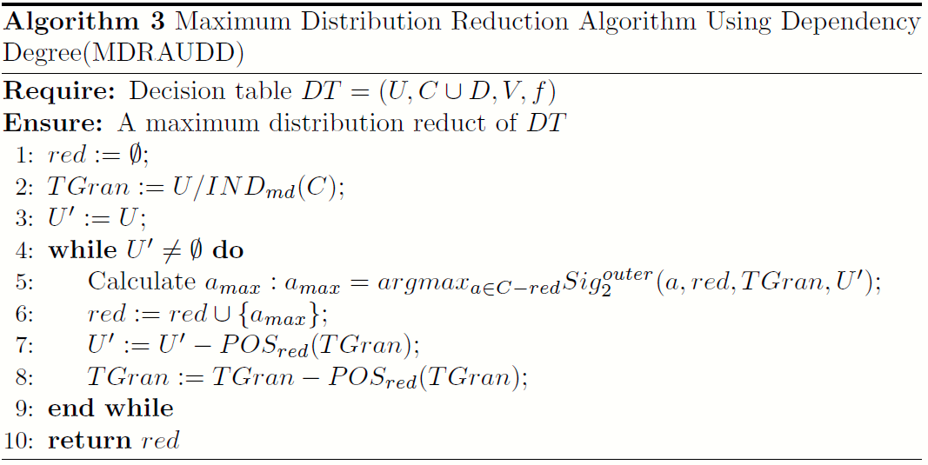
The more efficient algorithms

Slide 9
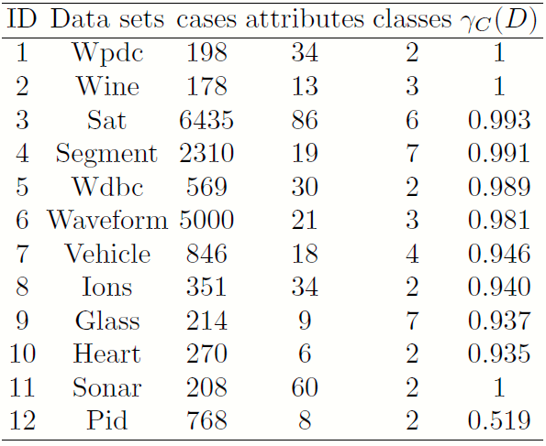
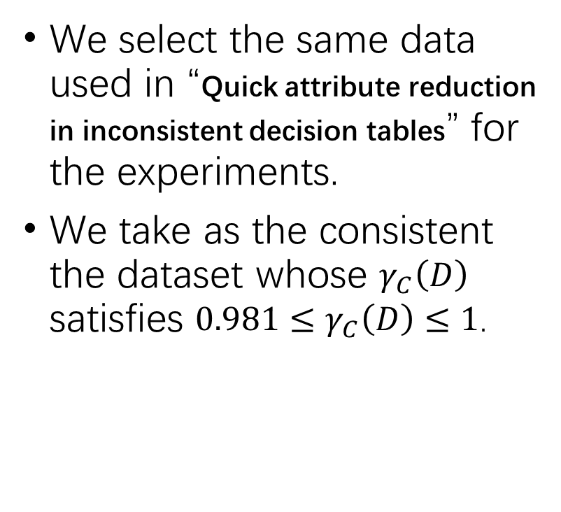
Experiments
We select the same data used in “Quick attribute reduction in inconsistent decision tables” for the experiments.
We take as the consistent the dataset whose $γ_{C}\left(D\right)$ satisfies ${0.981≤γ}_{C}\left(D\right)≤1$.

Slide 10
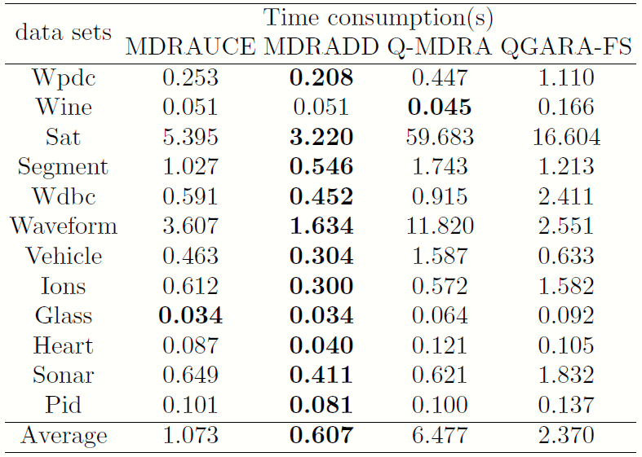
Time consumption
As shown in the right table, the proposed algorithms, i.e., MDRADD and MDRAUCE, are more efficient than the existing MDR algorithms.

Slide 11
Conclusions & Future work
After analyzing the indiscernibility relation of MDR, we propose two definitions of MDR with the conditional entropy and the dependency degree
Based on classic heuristic functions, we designed two novel heuristic algorithms, i.e., MDRAUCE and MDRADD, to efficiently find a maximum distribution reduct
Because the scale of data processed becomes larger and larger, the efficiency of attribute reduction algorithms is still the focus of future researches.

Slide 12
Thanks!

